Slide 1
Email Marketing Analysis
Drew Pickett, Abdirahman Ali, Matthew Grega, Julien Smith

Slide 2
Business Objective and Experiment Setup

Slide 3
Business Objective:
We want to determine what email strategies drive more user engagement and sales. To do so we will run statistical tests on previous email metrics gauging what tone of speech and days of the week produce better results via open rate, click rate, unsubscribe rate, etc. We will present our findings with visualizations and analyses.

Slide 4
Experiment Setup
Overview: Tested how email tone and send date affect customer engagement
Tone styles analyzed: conversational vs alarming
Send date: beginning in march, tracked day of the week
Analyzed data: Send date, subject line, tone group, and engagement results
Key metrics: Open rate, click rate, unsubscribe rate, and sales amount.
Goal: Identify patterns linked to stronger engagement
Notes:
We tested how email tone and send date influence the engagement in the email campaigns sent out to users. We compared two styles of tone, conversational and alarming along with tracking the day of the week the emails were sent as well beginning in March. Each email included engagement results, such as how many times they were opened, clicked on, and unsubscribed. The goal was to identify patterns associated with stronger customer engagement.

Slide 5
How did tone affect engagement rate?

Slide 6
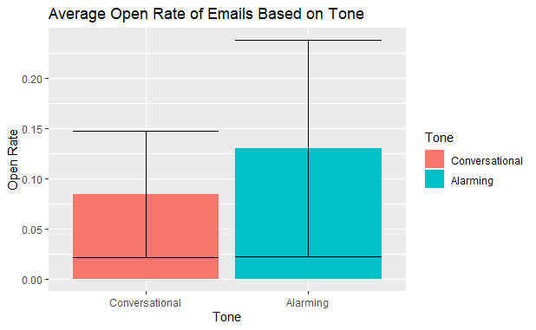
Results for Open Rate vs Tone
Conversational approach had an average open rate of ~0.08
Alarming approach had an higher open rate of ~ 0.13.
Alarming emails had a higher average open rate, but the performance was more variable.
Notes:
These black lines extending from the column chart are error bars, they represent + or - 1 standard deviation from the mean. A taller / longer error bar means more variability, whereas a more compact error bar indicates less variability
Regarding open rate, the conversational approach had a lower average open rate of 0.08, and the alarming approach had a higher average open rate of 0.13, and additionally the alarming tone also showed of a longer error bar, which could suggest greater variability in open rates compared to the conversational tone

Slide 7
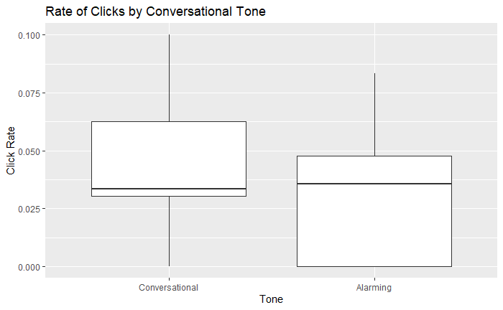
Results of Click Rate by Tone
Conversational tone’s Q1 starts higher
Alarming tone has a higher median
Alarming tone includes lower Q1 values
Notes:
The line in the middle shows the median, and the box itself represents the middle half of the data. Where the box starts represents q1, the lower quartile and where the box ends represents q3, the upper quartile. The lines extending outward shows how far the data spreads beyond the middle range.
From the graphs shown, we can see that regarding tones, the conversational tone had a higher quartile1, meaning the values of lower ranges were higher. The alarming tone shows a lower quartile1, but also shows a slightly higher median. This suggests that while alarming emails had more instances of lower click rates, the typical performance was still slightly higher than that of the conversational tone. Additionally, we can see the top whisker for the conversational tone being 0.1, whereas the top whisker for the alarming tone was closer to 0.08, meaning that the conversational tone also contained a higher upper range. Overall this suggests that hte conversational tone consisted of higher values in the lower range, as well as reaching a higher upper range. Additionally, the alarming tone shows a slightly higher median, meaning the typical click rate was slightly higher despite having more instances of low values. Therefore conversational emails were more consistent overall, with fewer low extreme outcomes, although alarming email achieved slightly higher click rates.

Slide 8
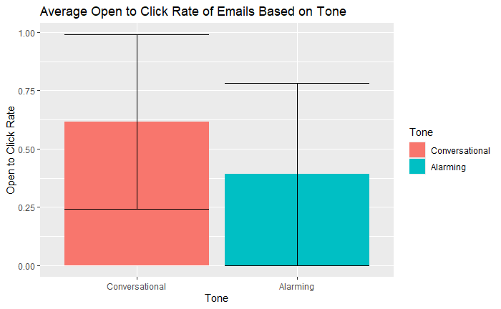
Average rate of open to clicks based on tone
Conversational tone had an avg. open to click rate of ~0.6
The alarming tone had a avg open rate of ~0.35
Conversational tone had a higher open to click rate ratio
Notes:
For open to click rate, we can see that the conversational approach once again did better regarding open to click rate with a rate of 0.60, whereas the alarming tone had a rate of 0.35. The error bars are roughly of similar length which suggests similar variability

Slide 9
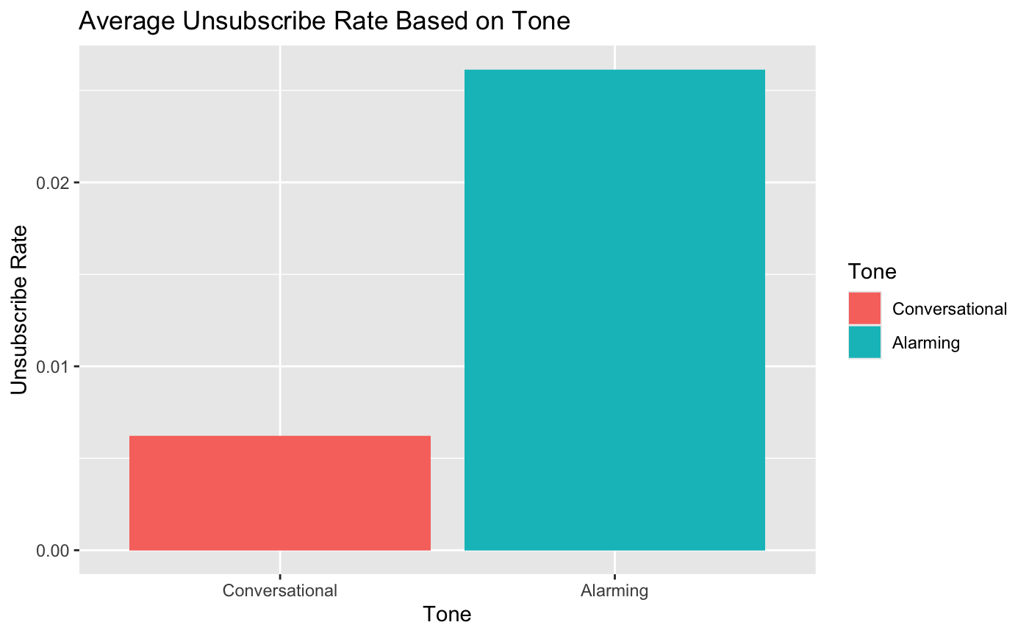
Unsubscribe Rate by Tone
Alarming promoted unsubscribing.
Results were statistically significant.
Conversational recommended to retain more subscribers.

Slide 10
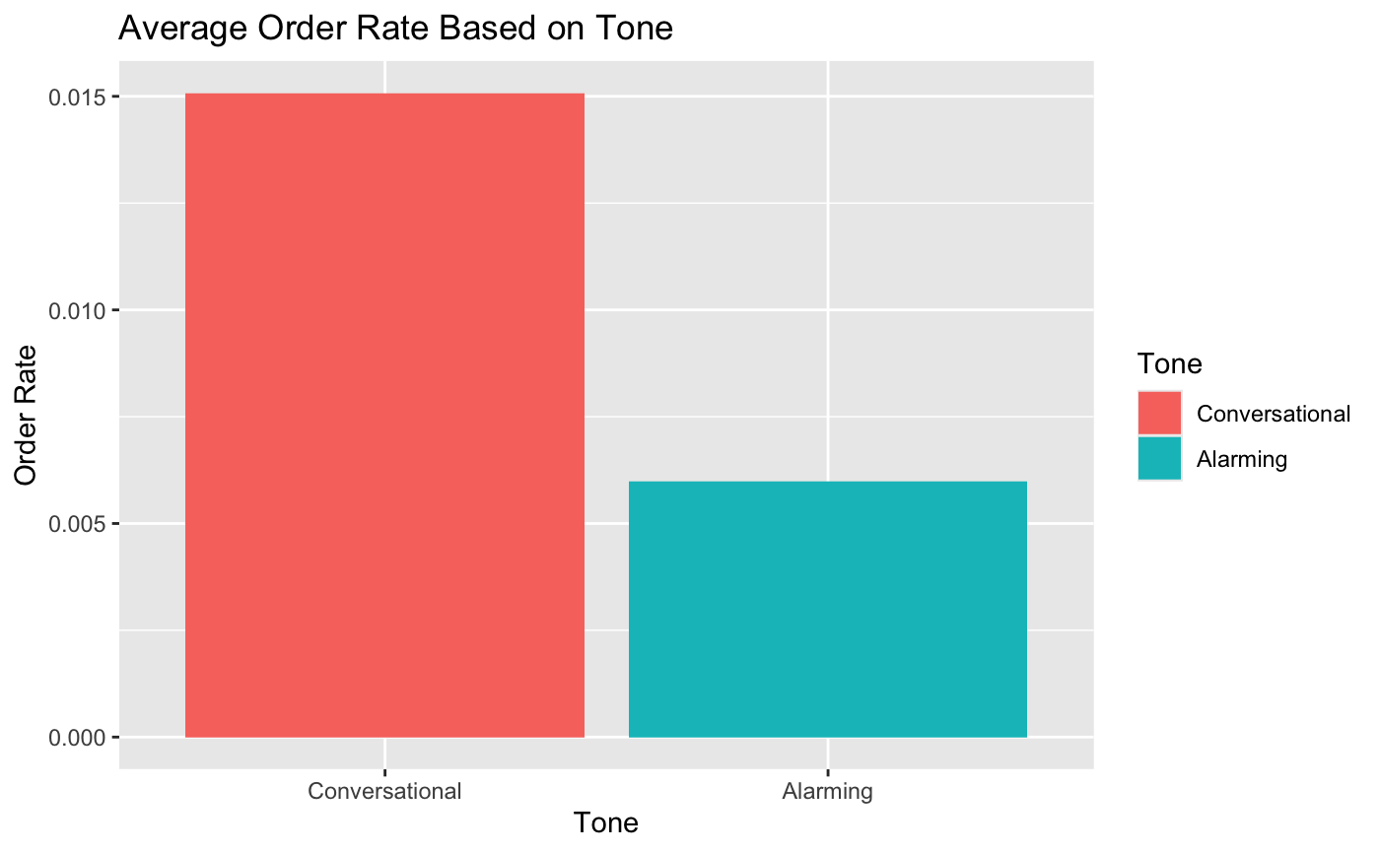
Order Rate by Tone
Conversational has greater order rate.
Results were statistically significant.
Conversational recommended to increase order rate.

Slide 11
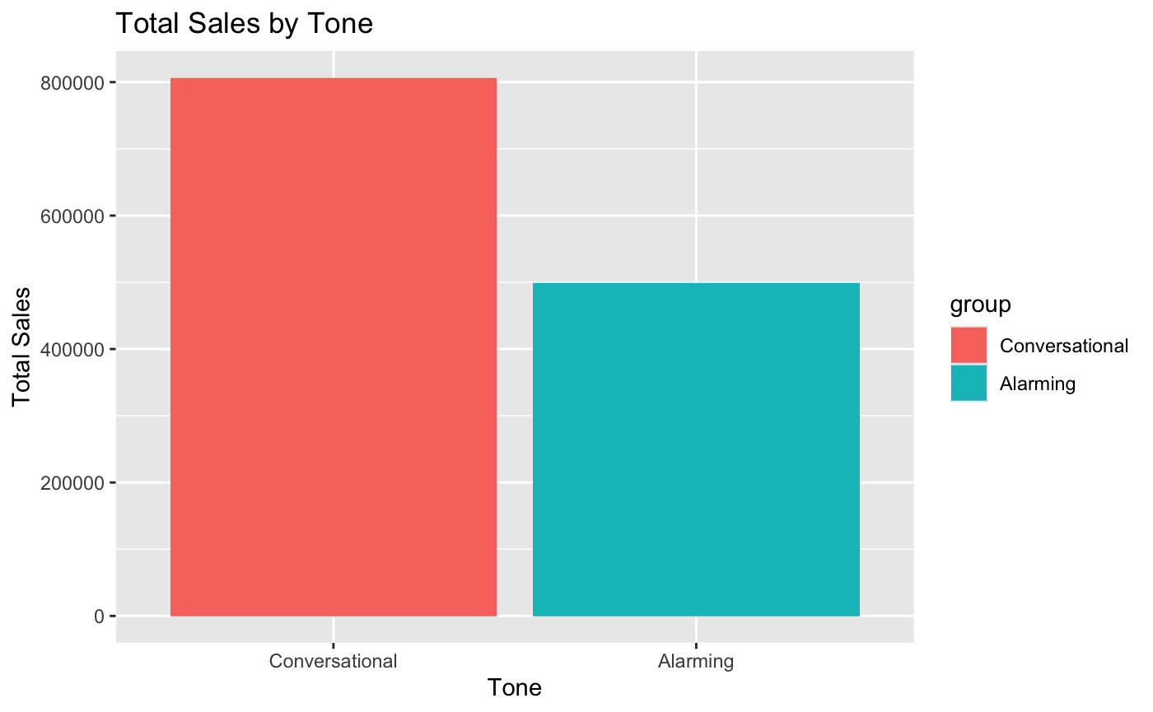
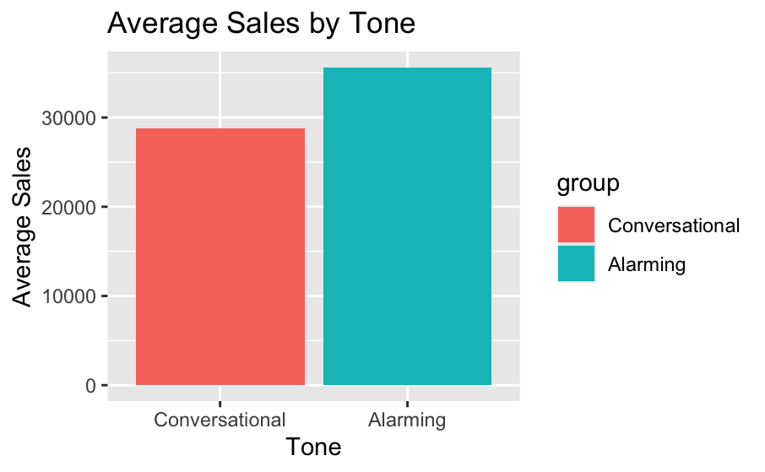
Sales by Tone
Conversational has greater total sales.
Alarming has greater average sales per order.
Average sales per order by tone failed to reject null hypothesis. (P-value = 20%)
Total orders = 42, Conversational = 28, Alarming = 14.
Conversational recommended for greater number of orders and sum of sales.

Slide 12
How did day of the week affect engagement?

Slide 13
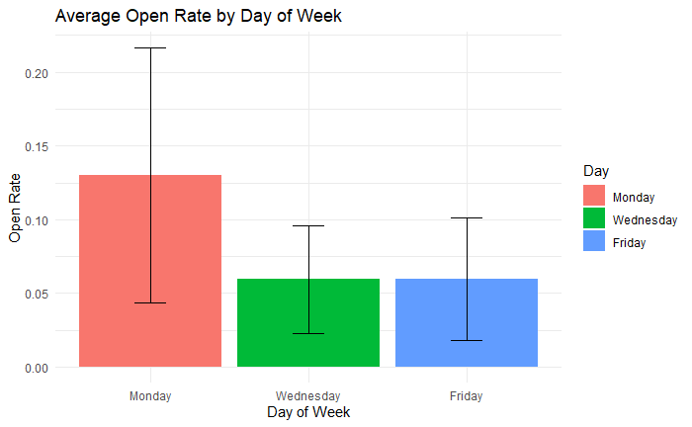
Mondays = Engagement
When an email is sent on a Monday, it has almost double the chance to be opened.
Although Monday has a higher variance in its open rate, it is still the clear leader above Wednesday and Friday

Slide 14
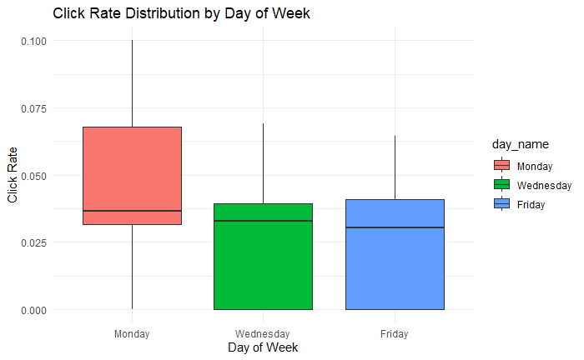
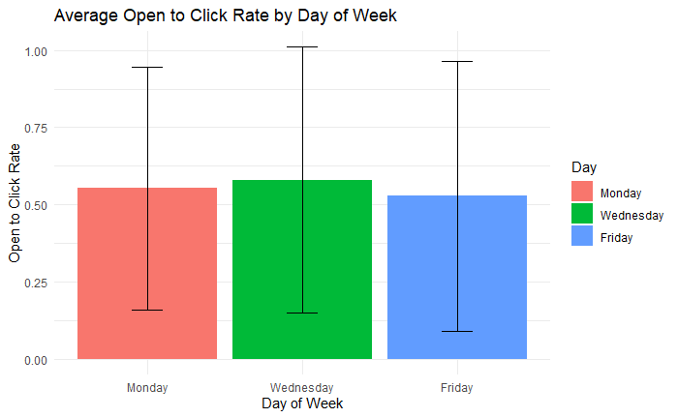
Day of Week: Click Rate
Consistency & Click to Open Rate
The median click rate is roughly the same across all days.
Once a customer opens an email, they are just as likely to click on the email’s contents, regardless of the day.
Since 50% is a high Click to Open Rate, our main goal should be that the user is opening the email.

Slide 15
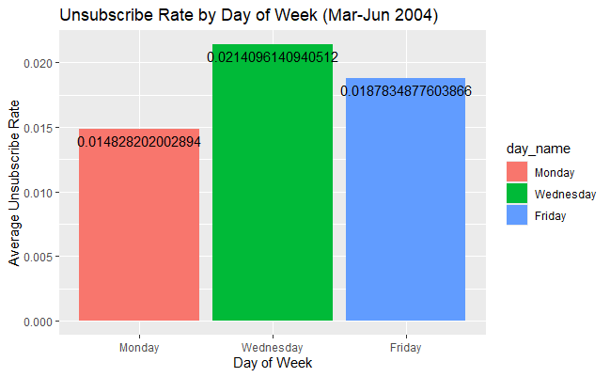
Unsubscribe Rate by Day of Week
Although Wednesday shows a higher unsubscribe rate visually, the ANOVA test indicates that there's no statistical significant different between days by p = 0.538.
This would mean that the variation in unsubscribe rate across the days could be attributed to random fluctuation rather than timing.
The business takeaway would be that the send date doesn’t meaningfully impact unsubscribe behavior.

Slide 16
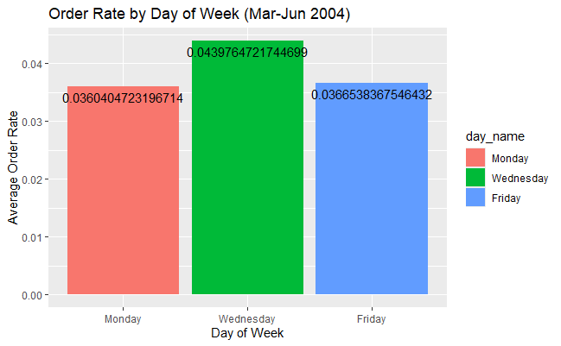
Order Rate by Day of Week
While Wednesday appears to have a slightly higher order rate, the ANOVA test shows no statistical different across days by p = 0.503.
The observed differences cannot be large enough to lead to the conclusion that the send dates drives or influences ordering behavior.
The business takeaway would be that order performance is stable across the days of the week.

Slide 17
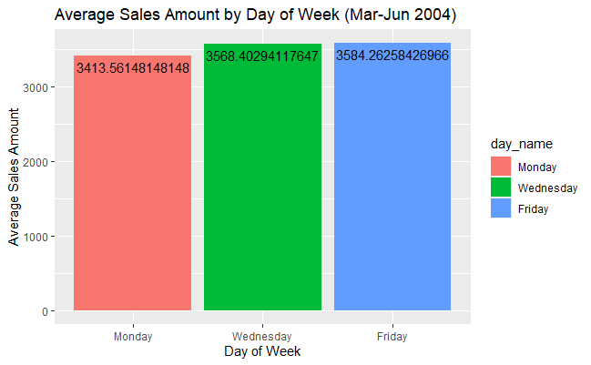
Average Sales Amount by Day of Week
(March - June 2004)
The ANOVA test when used for average sales amount by days of the week, we find that there is no statistical difference in average sales by day of week by context of p = 0.859.
And yes, visually Friday shows the highest average sales, this difference does not hold any statistical meaning.
The business takeaway would be that sales revenue has no dependence on send dates.

Slide 18
Key takeaways and recommendations

Slide 19
Summary of Findings
Although the alarming tone showed a higher average open rate, the conversational approach achieved stronger engagement in click rate and open to click rate.
The conversational tone showed stronger engagement overall, while variability differed depending on metric.
Conversational tone recommended, promotes positive engagement and more orders
Monday is the day customers are most likely to open emails, and since we have an engaged customer base, getting them to open the emails is key.
Notes:
We determined the conversational tone promoted more positive user engagement via open to click rate, unsubscribe rate, and order rate. Net sales was also greater due to the increased order rate. Additionally, we found that Monday is our best day for sending emails and receiving back positive user engagement via open rate and click rate.

Slide 20
Summary of Findings
The key findings also to keep in mind are that:
No statistically significant difference in unsubscribe rate by day.
No statistically significant difference in order rate by day.
No statistically significant difference in avg. sales amount by day.
For strategic recommendation purposes, proposed with the best interests of the stakeholders in mind are:
The company can choose send dates based on convenience in terms of operational duties.
Future testing could explore other variables such as time of day, customer segmentation, etc.
And perhaps with greater exposure to greater data sets, such propositions for future testing can be made possible for the analytics team here at Timeless Transport Models.

Slide 21
Thank You

